Slide 1
Deep neural networks for Youtube recommendations
Arnab Dana
Department of Computer Science and Engineering
National Institute of Technology
Uttarakhand, India

Slide 2
ABSTRACT
YouTube represents one of the largest scale and most sophisticated industrial recommendation systems in existence. In this paper, we describe the system at a high level and focus on the dramatic performance improvements brought by deep learning. The paper is split according to the classic two-stage information retrieval, we detail a deep candidate generation model and then describe a separate deep ranking model. We also provide practical lessons and insights derived from designing, iterating and maintaining a massive recommendation system with enormous user facing impact

Slide 3
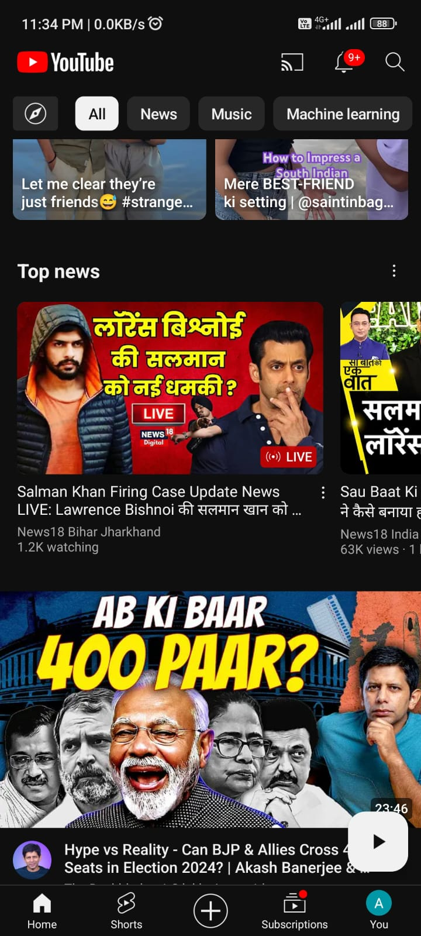
Example of Youtube recommendations

Slide 4
Table Of Contents
Challenges
System Components
System Overview
Candidate Generation
Model Architecture
Experiments with Features and Depth
Ranking
Feature Representation
Modeling Expected Watch Time
Experiments with Hidden Layers
Example of Age of Video Feature
Conclusions

Slide 5
Challenges
Challenges | Description
Scale | Existing recommendation algorithms that work well on small datasets struggle to perform effectively at YouTube's massive scale.
Freshness | YouTube's dynamic nature with a constant influx of new video uploads requires the recommendation system to quickly adapt and model fresh content.
Noise | Predicting user behavior on YouTube is challenging due to sparse data, various external factors, and poorly structured metadata associated with content.

Slide 6
System Component | Description
Neural Networks | The system consists of two neural networks: one for candidate generation and one for ranking.
Candidate Generation | In this phase, the vast YouTube corpus is filtered to hundreds of videos potentially relevant to the user's interests.
Ranking | The ranking network utilizes impression data to fine-tune and personalize candidate predictions for the user interface, enhancing relevance and user experience.
Conclusion | The process of selecting the surrogate problem for recommendations involves a balance of art and science, reflecting the complexity of user preferences.

Slide 7
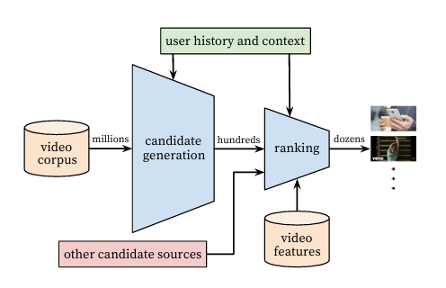
SYSTEM OVERVIEW
Recommendation system architecture demonstrating the funnel where candidate videos are retrieved and ranked before presenting only a few to the user.

Slide 8
﻿• The system is comprised of two neural networks: one for candidate generation and one for ranking.
• The candidate generation network takes events from the user's YouTube activity history as input and retrieves a small subset (hundreds) of videos from a large corpus(billions of videos).
• Presenting a few "best" recommendations in a list requires a fine-level representation to distinguish relative importance among candidates.

Slide 9
CANDIDATE GENERATION
﻿The candidate generation network only provides broad personalization via collaborative filtering. The similarity between users is expressed in terms of features such as IDs of video watches, search query tokens and demographics.

Slide 10
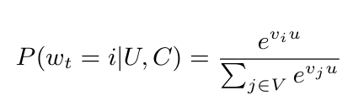
Recommendation as Classification
We pose recommendation as extreme multiclass classification where the prediction problem becomes accurately classifying a specific video watch wt at time t among millions of videos i (classes) from a corpus V based on a user U and context C,
where “u” a high-dimensional embedding of the user, context pair. “v” represent embeddings of each candidate video.
In this setting, an embedding is simply a mapping of sparse entities (individual videos, users etc.) into a dense vector.
The task of the deep neural network is to learn user embeddings “u” as a function of the users history and context that are useful for discriminating among videos with a softmax classifier.

Slide 11
Model Architecture
A user's watch history is represented by a variable length sequence of sparse video IDs mapped to a vector representation via the embeddings.
The embedding for each video is learned by bag of words jointly with model parameters through gradient descent backpropagation updates.
Features are concatenated into a wide first layer, followed by several layers of fully connected Rectified Linear Units (ReLU).

Slide 12
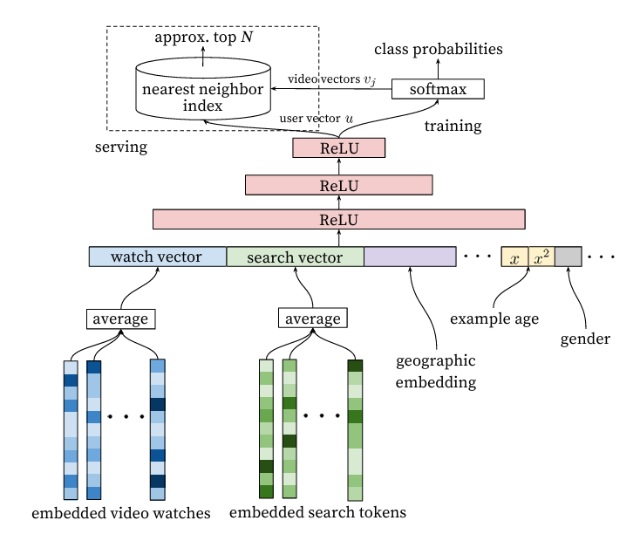
Deep candidate generation model uses embedded sparse features concatenated with dense features, with averaged embeddings for variable-sized bags of sparse IDs.
Hidden layers are fully connected, trained using cross-entropy loss and gradient descent on sampled softmax output.
Serving involves approximate nearest neighbor lookup to generate hundreds of candidate video recommendations.

Slide 13
Heterogeneous Signals
A key advantage of using deep neural networks as a generalization of matrix factorization is that arbitrary continuous and categorical features can be easily added to the model (normalized [0,1]).
For Example :
Search History + Watch History
Demographic Features
Gender
Age

Slide 14
Label and Context Selection
The goal is to recommend videos to users based on the preferences and choices of similar users, as determined by collaborative filtering techniques. Instead of relying solely on explicit user ratings or interactions, this approach leverages the collective behavior of users to make personalized video recommendations.
We improved metrics by giving equal weight to all users in training, avoiding domination by a few highly active users.
Showing the user's last search page as homepage recommendations doesn't work well.

Slide 15
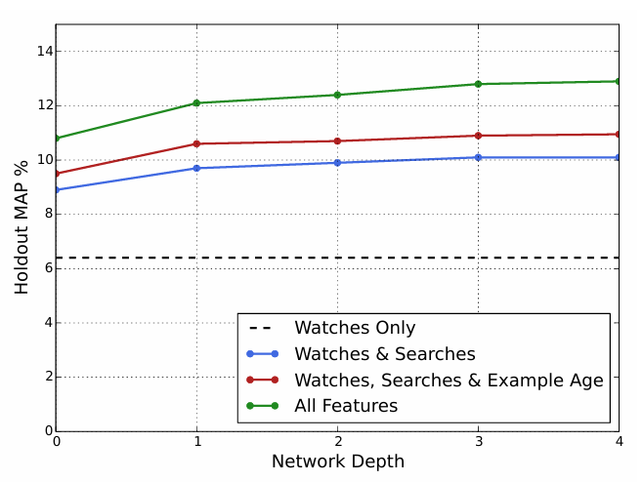
Experiments with Features and Depth
Depth 0: A linear layer simply transforms the concatenation layer to match the softmax dimension of 256
Depth 1: 256 ReLU
Depth 2: 512 ReLU 256 ReLU
Depth 3: 1024 ReLU 512 ReLU 256 ReLU
Depth 4: 2048 ReLU 1024 ReLU 512 ReLU 256 ReLU

Slide 16
Ranking
The ranking network accomplishes the task by assigning a score to each video according to a desired objective function using a rich set of features describing the video and user. The highest scoring videos are presented to the user, ranked by their score.
We use a deep neural network with similar architecture as candidate generation to assign an independent score to each video impression using logistic regression. The list of videos is then sorted by this score and returned to the user.

Slide 17
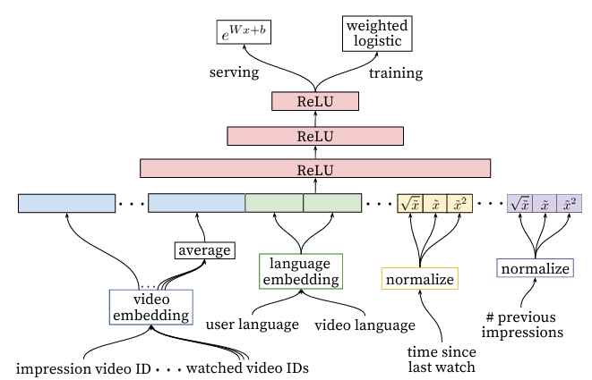

Slide 18
Feature Representation
﻿Feature Engineering: The main challenge is in representing a temporal sequence of user actions and how these actions relate to the video impression being scored. We observe that the most important signals are those that describe a user's previous interaction with the item itself and other similar items, matching others' experience in ranking ads.
how many videos has the user watched from this channel?
When was the last time the user watched a video on this topic?
These continuous features describing past user actions on related items are particularly powerful factors affecting rank.

Slide 19
Feature Representation
﻿Embedding Categorical Features: Categorical Features are condensed down using embeddings suitable for neural networks.
Normalizing Continuous Features: Neural networks are notoriously sensitive to the scaling and distribution of their inputs, so we normalize the features so that they are equally distributed in [0,1).

Slide 20
Modeling Expected Watch Time
﻿Our goal is to predict expected watch time given training examples that are either positive (the video impression was clicked) or negative (the impression was not clicked).
Positive examples are annotated with the amount of time the user spent watching the video. To predict expected watch time we use the technique of weighted logistic regression, which was developed for this purpose.
Negative examples in this context are annotated as instances where the video impression was not clicked. They don't have a specific time value associated with them because the user did not spend any time watching the video. So, in the dataset, negative examples are labeled simply as instances where the user did not engage with the video by clicking on it.

Slide 21
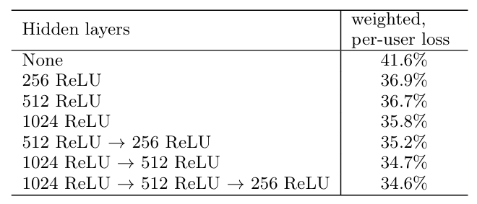
Experiments with Hidden Layers

Slide 22
Experiments with Hidden Layers
Increasing the width and depth of hidden layers improves results, but it comes with a trade-off of increased server CPU time for inference.
A configuration of 1024-wide ReLU, followed by 512-wide ReLU, then 256-wide ReLU, gave the best results while staying within CPU budget.
Trying the same configuration with only normalized continuous features (without their powers) led to a slight increase in loss.
Training a model with equal weighting for positive and negative examples dramatically increased the watch time-weighted loss by 4.1%.

Slide 23
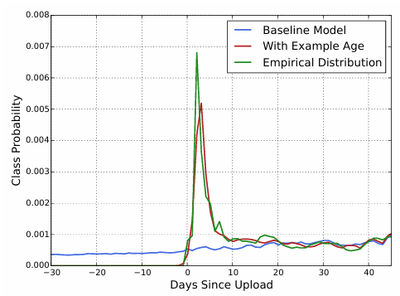
Example of Age of Video Feature
The baseline model is a mathematical model that tries to predict how often videos are uploaded at different ages. The empirical distribution likely refers to the actual observed data on how often videos are uploaded with different ages.
In essence, the graph depicts a baseline model (prediction) of how often videos are uploaded at various ages being compared to the actual data (empirical distribution).

Slide 24
CONCLUSIONS
The model effectively integrates multiple signals and their interactions, surpassing previous matrix factorization methods used at YouTube.
Classifying future watches performed well by capturing co-watch behavior and preventing information leakage.
Using training example age as a feature reduced bias towards past data, improving offline precision and increasing watch time on new videos.
Deep learning outperformed traditional methods in ranking and predicting watch time, especially with specialized features and embeddings.
Weighted logistic regression improved performance by considering watch time, leading to better ranking evaluation metrics compared to click-through rate prediction.

Slide 25
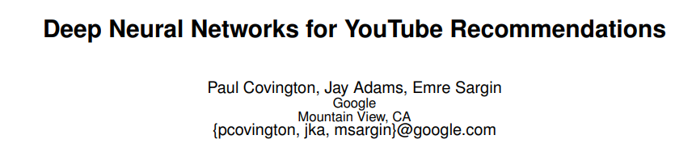
REFERENCES
https://storage.googleapis.com/gweb-research2023-media/pubtools/pdf/45530.pdf

Slide 26
Thank You

